Slide 1
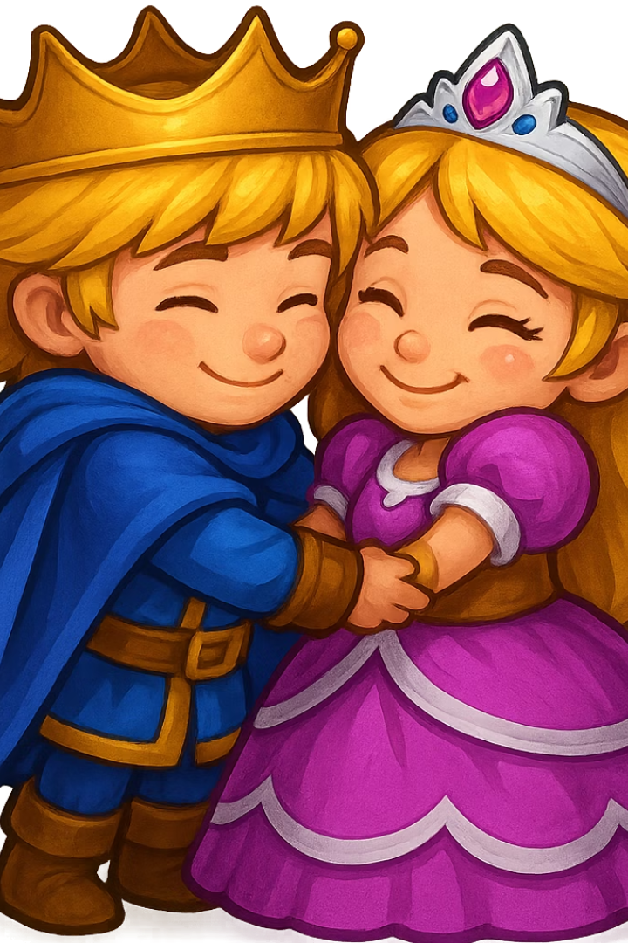
Prince’s Pursuit: When love becomes a trial.
Presented by: Gayathri Poluri

Slide 2
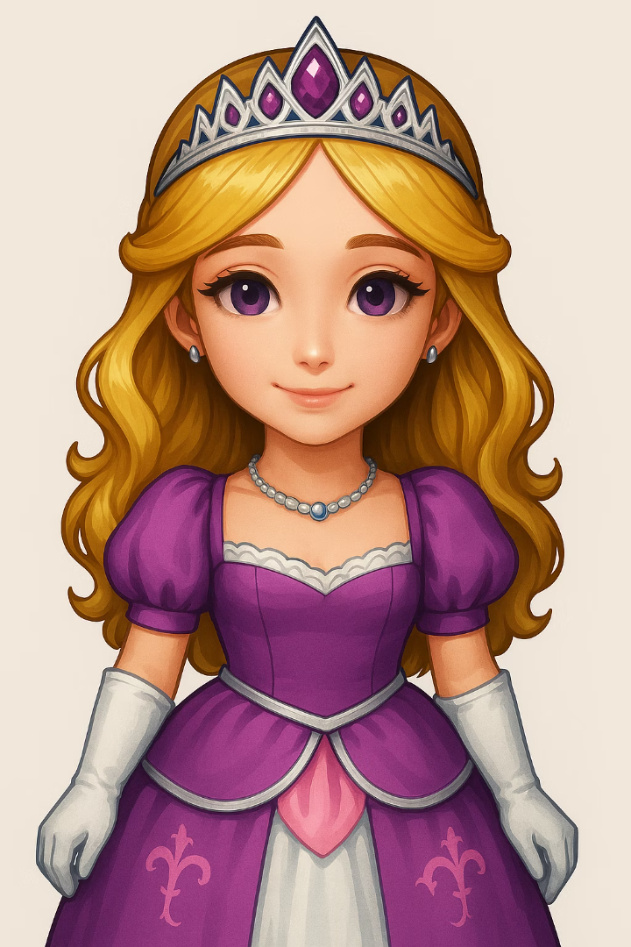
Overview
A Quest of Confession
“It’s not just a run. It’s a confession.”
Princess Mitravinda's Curse
She is bound by ancient magic.
Bhairava's Love in Action
He must prove his devotion through deeds.
Collect 5 Gems
These mystical gems will break the curse.

Slide 3
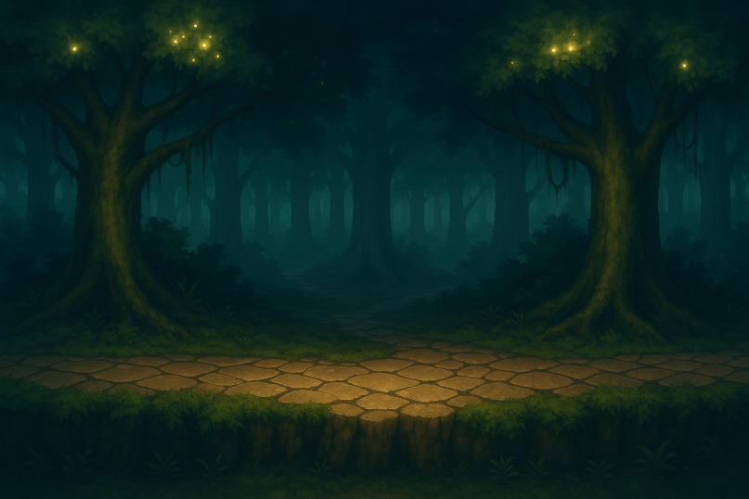
Aesthetics:
Sensation:
Rich Parallax forest visuals, glowing shaders, custom outlines, and fireflies.
HUD dynamically updates timer (turns red below 30s) and gem count.

Slide 4
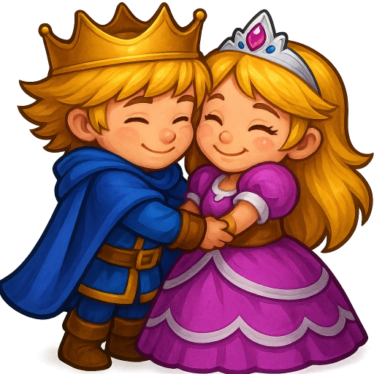
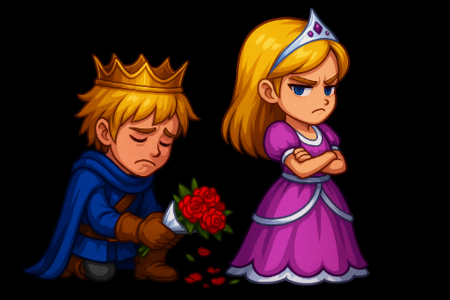
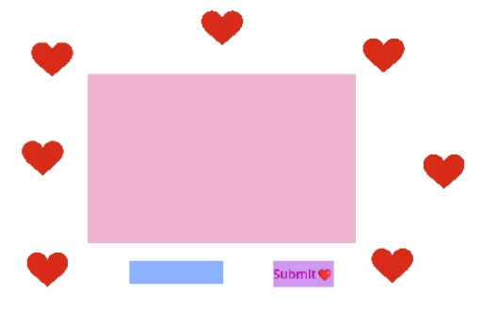
Narration
Happy End
Sad End
LoveLetterPanel
If gems collected 5 or satisfied with the letter
If gems collected or less than 4
If gems collected are 4

Slide 5

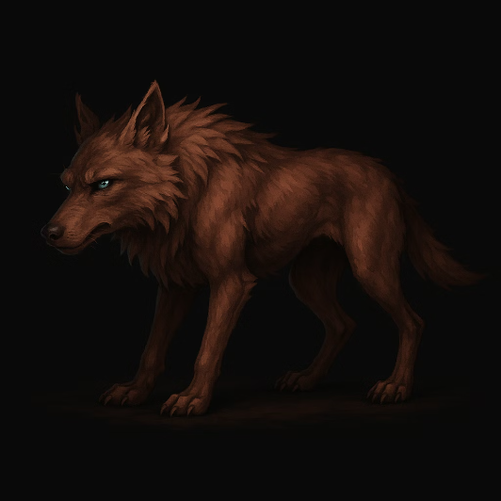
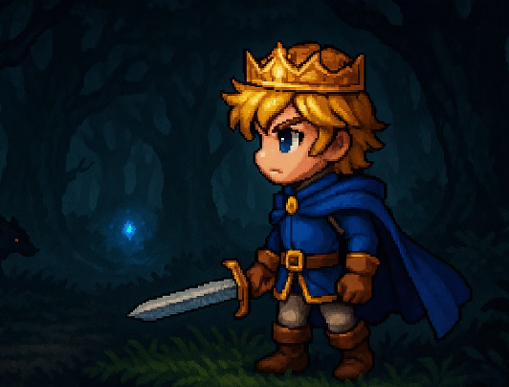
Mechanics
Movement
Gem Collection
Enemy Spawning
Fast-paced, smooth 2D platforming using CharacterBody2D.
Gems spawn randomly using RayCasts and Factory Method.
Cursed wolves attack. Touch = -20 health.
Spawn is randomized, respects collision, and avoids clumping.
Physics-driven motion and move_and_slide() ensure responsive feel.
Shader glow (gem_pulse.gdshader) helps visually guide players.

Slide 6
Functionality & Software Highlights
🧠 AI & Systems:
EnemySpawner uses AI to avoid player, ground collisions.
Singleton (World) handles gem count, endings, HUD.
🎮 Core Systems Built:
Gem Spawner (Factory Pattern)
LoveLetterPanel (Builder Pattern)
World Control (Facade + Observer Patterns)
Enemy AI (Strategy Pattern)
🧪 Shaders:
gem_pulse.gdshader, enemy_flash.gdshader, bg-tint.gdshader, player-outline.gdshader.

Slide 7
Lessons Learned📖
Do not reorganise the scripts/images/folders outside of godot file Manager
Always check if the signals are working fine
Create seperate scenes and add them as child scene to avoid confusions

Slide 8
Live Demo😉
Let's get started ….

